Slide 1
An Introduction to Natural Language Processing
Lawrence Carin
Duke University
Electrical & Computer Engineering Department

Slide 2
Lecture 1

Slide 3
What is happening today?
We are first going over the basics of “natural language processing”
Want to be able to automatically make sense of written language (whether “natural” or not!)
Later sessions will go through specific case studies
First, what can we do with natural language processing?

Slide 4


Sentiment Analysis
Machine Learning Model
“That movie was terrible!”
“This is the best jacket that I’ve ever owned”
“Not really that good.”

Slide 5
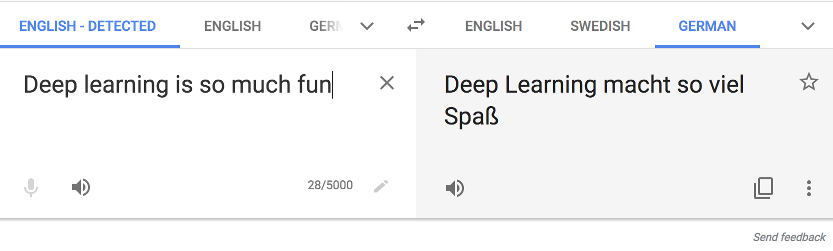
Text Translation
translate.google.com

Slide 6
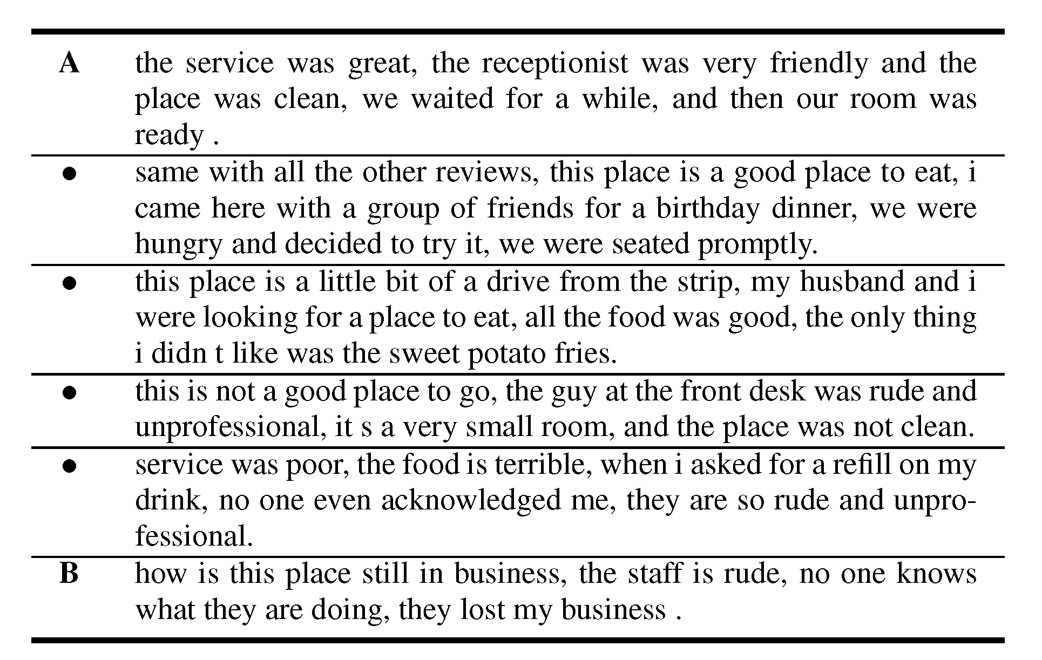
Automatic Text Synthesis

Slide 7
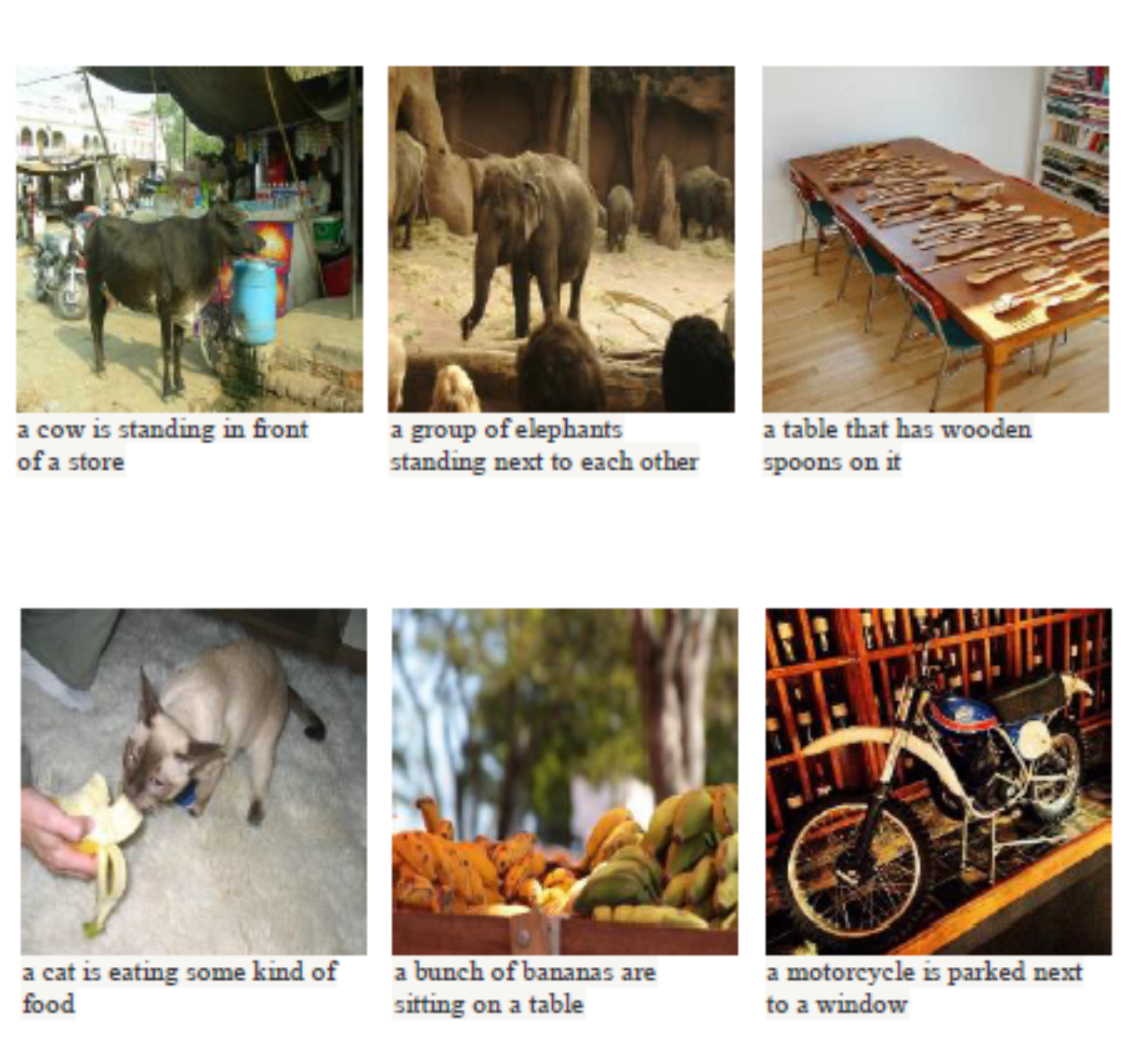
Automatic Image Captioning

Slide 8
How does this fit in our Previous Framework?

Slide 9
Sentiment Analysis
Machine Learning Model
“That movie was terrible!”
“This is the best jacket that I’ve ever owned”
“I’m pretty ambivalent about the whole thing. Not really that good.”
This is a binary classification, just like logistic regression!

Slide 10

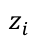
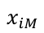
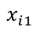
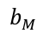
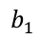
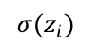
Revisiting Logistic Regression
Convert to Probability
$${σ(z}_{i})$$
$$z_{i}$$
Linear Model
$$b_{1}$$
$$b_{M}$$
$$x_{i1}$$
$$x_{iM}$$

Slide 11
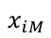
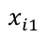
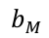
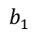
Revisiting our Linear Predictive Model
$$z_{i}$$
$$b_{1}$$
$$b_{M}$$
$$x_{i1}$$
$$x_{iM}$$
$$z_{i}=(b_{1}×x_{i1})+\left(b_{2}×x_{i2}\right)+⋯+\left(b_{M}×x_{iM}\right)$$
Big issue: we do not have a vector of features…

Slide 12
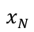
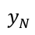
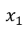
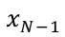
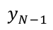
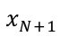
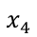
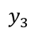
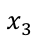
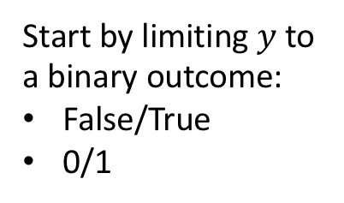
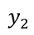
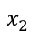
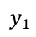
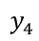
Our Previous Training Set Setup
$$x_{1}$$
$$y_{1}$$
$$x_{2}$$
$$y_{2}$$
$$x_{3}$$
$$y_{3}$$
Start by limiting $y$to a binary outcome:
False/True
0/1
$$x_{4}$$
$$y_{4}$$
$$x_{N−1}$$
$$y_{N−1}$$
$$x_{N}$$
$$y_{N}$$
New Data
$$x_{N+1}$$
?
Want to learn how to predict outcome

Slide 13
Our Previous Training Set Setup
$$x_{1}$$
$$y_{1}$$
$$x_{2}$$
$$y_{2}$$
$$x_{3}$$
$$y_{3}$$
Start by limiting $y$to a binary outcome:
False/True
0/1
$$x_{4}$$
$$y_{4}$$
$$x_{N−1}$$
$$y_{N−1}$$
$$x_{N}$$
$$y_{N}$$
New Data
$$x_{N+1}$$
?
Want to learn how to predict outcome

Slide 14
Our Training Set is Text
$$x_{1}$$
“That movie was terrible!”
$$y_{1}$$
$$x_{2}$$
“This is the best jacket…”
$$y_{2}$$
$$x_{3}$$
“Most awful thing ever…”
$$y_{3}$$
Start by limiting $y$to a binary outcome:
False/True
0/1
$$x_{4}$$
“One of the most amazing…”
$$y_{4}$$
$$x_{N−1}$$
“Will never buy again…”
$$y_{N−1}$$
$$x_{N}$$
“I’m rejuvenated…”
$$y_{N}$$
New Data
$$x_{N+1}$$
“This class is great!”
?
Want to learn how to predict outcome

Slide 15
Algorithms work on numbers
A simple question:
“Can we convert our text to a vector or sequence of numbers?”
If yes, we can start using our previous methodology!

Slide 16
First approach: Counting
Let’s define a dictionary of vocabulary words
Each word is assigned an index
Count the number of times that each word appears in each text example
“That was a good, really good, game last night”
Counting word occurrences
good:2, that:1, was:1, a:1, really:1, game:1,
last:1, night:1

Slide 17
Counting the number of occurrences
The format is: index:count
Each section of text is now a vector, where the m^{th} entry is the number of times the m^{th} dictionary word occurred in that example.

Slide 18
Revisiting Logistic Regression
Convert to Probability
$${σ(z}_{i})$$
$$z_{i}$$
Linear Model
$$b_{1}$$
$$b_{M}$$
$$x_{i1}$$
$$x_{iM}$$
Word Counting
“This class is great!”

Slide 19
Quick Comments
This word counting strategy can work decently well in practice
Can easily put in our deep models instead
But we’re not really processing “natural” language
Don’t capture word relationships (e.g. “not bad”=“good”)
Don’t capture word similarity (“cat” and “dog” are both pets, “lawyer” and “attorney” are synonyms)
Can we capture these types of relationships?

Slide 20
Word EMBeddings

Slide 21
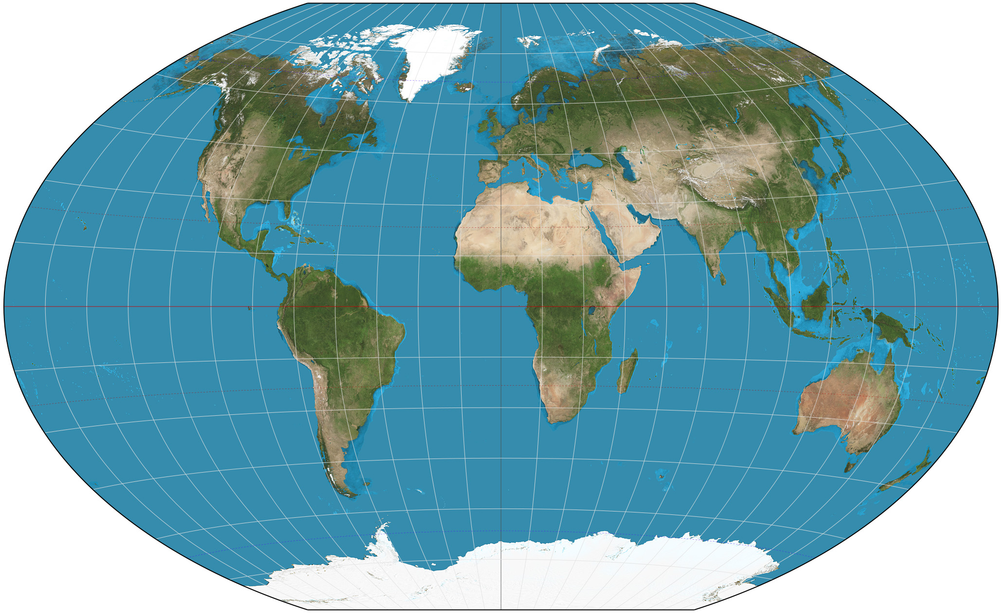
Similarities Based on Proximity
Points that are nearby spatially are likely to have similar attributes
May think of each location is a point in a 2D space (lat,long)
Measure similarity between places by their distance in 2D space

Slide 22
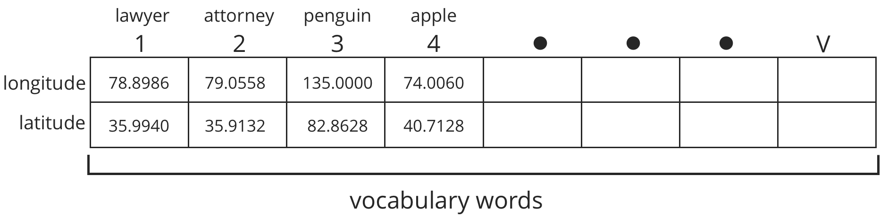
Map Each Word in Vocabulary to a Point in Space
Each word in a vocabulary is mapped to a point in a 2D space
The closer words are in the mapping, the more related/synonymous they are
The algorithm will learn the 2D point at which to place each word

Slide 23
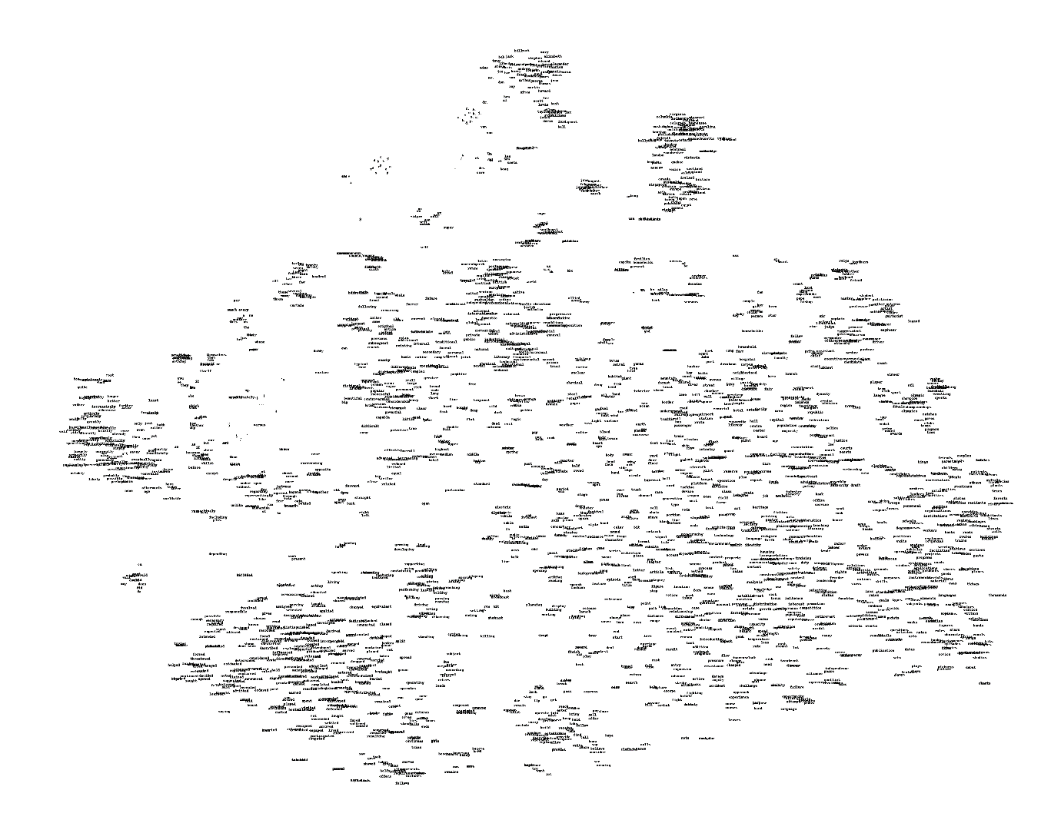
Example Word Geography
Here we show the learned geography of many different vocabulary words.
Too many words here to see! Let’s zoom in on a smaller section.

Slide 24
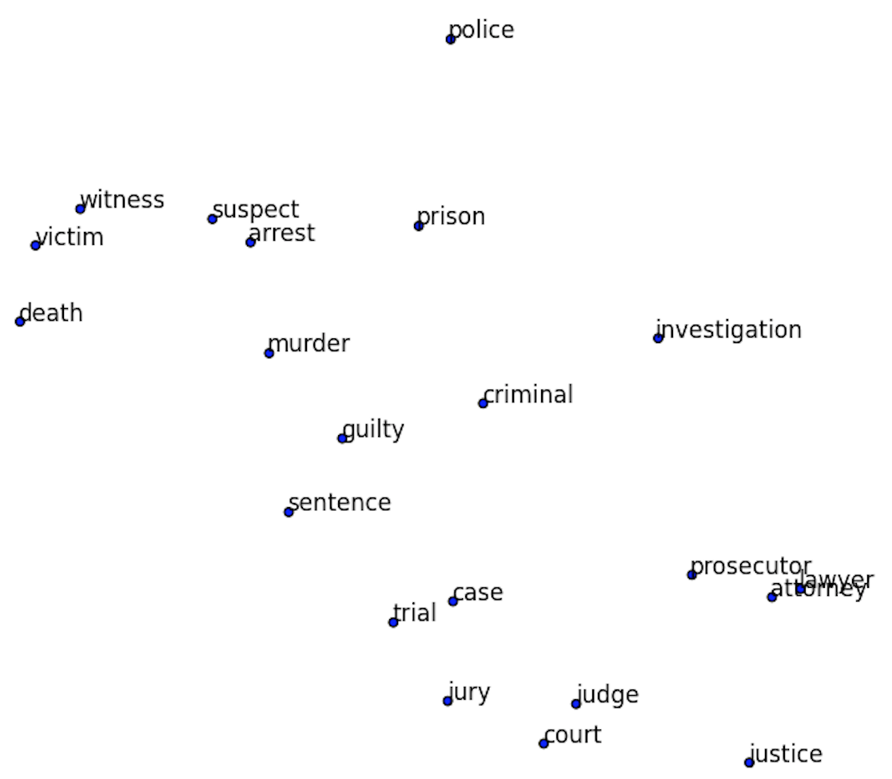
Example Word Geography
If we zoom in on a small region of our word map, it’s all related words.
Note the similarity of all the words as a whole, but also of the individual neighbors.
“Lawyer” and “attorney” are nearly identical in space!

Slide 25
Learn Geographical Relationships
The relationship between words can be maintained, we can do mathematical operations on these word vectors.
Add the same vector distance between man and woman will convert uncle to aunt and king to queen.
Plural relationships are also maintained.

Slide 26
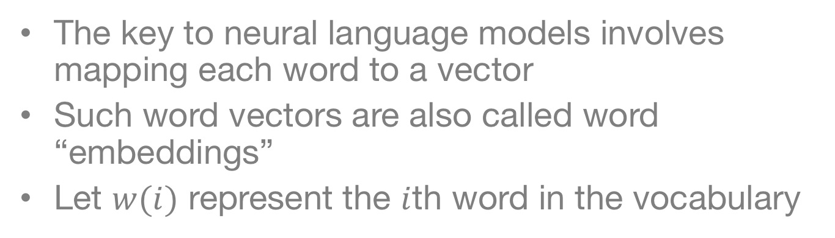
Word to Vector (Word2Vec)
The key to neural language models involves mapping each word to a vector
Such word vectors are also called word “embeddings”
Let $w(i)$ represent the $i$th word in the vocabulary

Slide 27
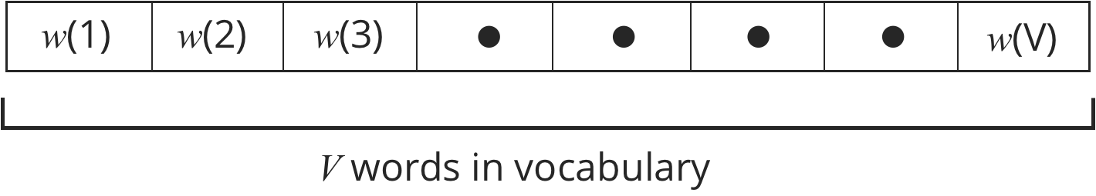
Word to Vector (Word2Vec)
Can think Word2Vec as a dictionary
Look up each word in the dictionary
If the word is in the dictionary, then we can look up the “definition” or location for it

Slide 28
Do we use 2-dimensional embeddings?

Slide 29
Do we use 2-dimensional embeddings?
2-dimensional locations are useful to illustrate similarity
Computationally, it turns out to be much easier to give each word a much longer address
Also representation is easier:
1 direction for plural
1 direction for past tense
1 direction for gender
etc…
The location vector will have M different entries
This is just like specifying a longer address (e.g. state, city, zip, street, house color, car color, etc…)

Slide 30
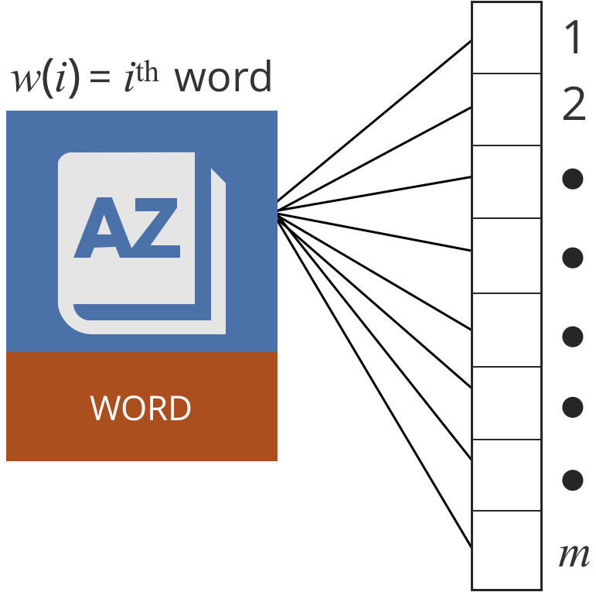
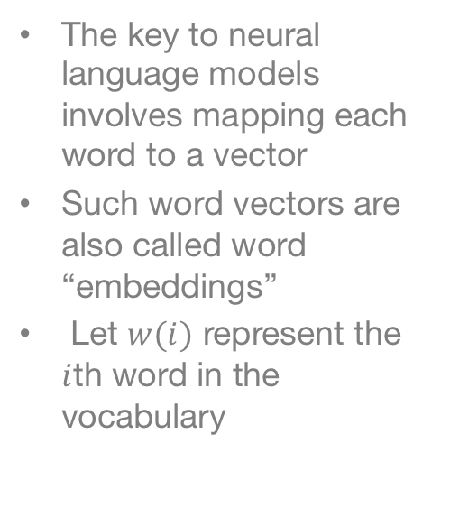
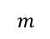
Word to Vector (Word2Vec)
The key to neural language models involves mapping each word to a vector
Such word vectors are also called word “embeddings”
Let $w(i)$ represent the $i$th word in the vocabulary
$$m$$

Slide 31
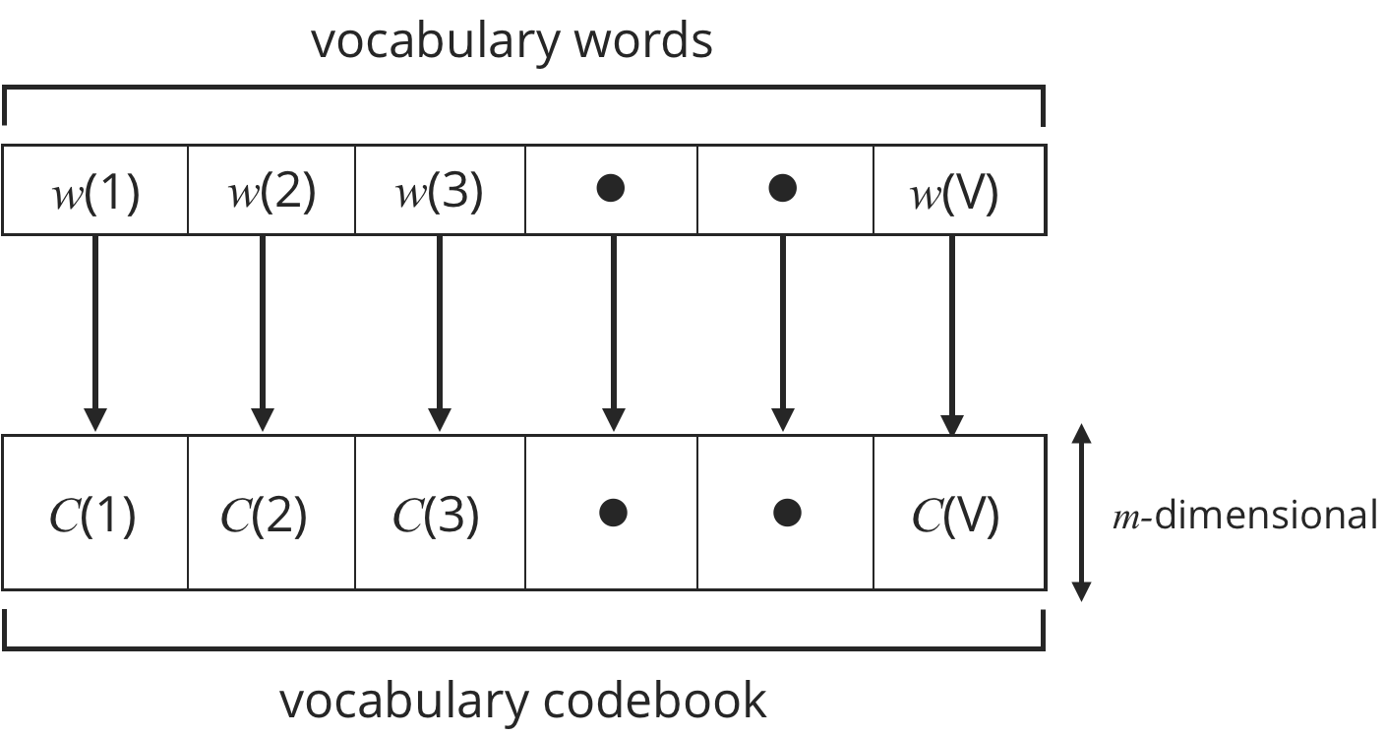
Word to Vector (Word2Vec)
The set of words in the vocabulary mapped to a codebook of vectors

Slide 32
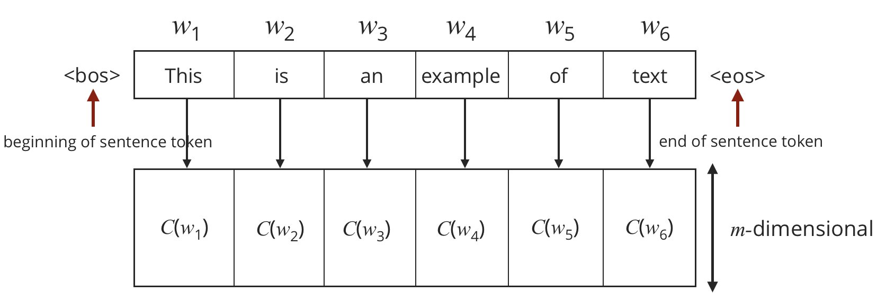
Looking up locations in a dictionary

Slide 33
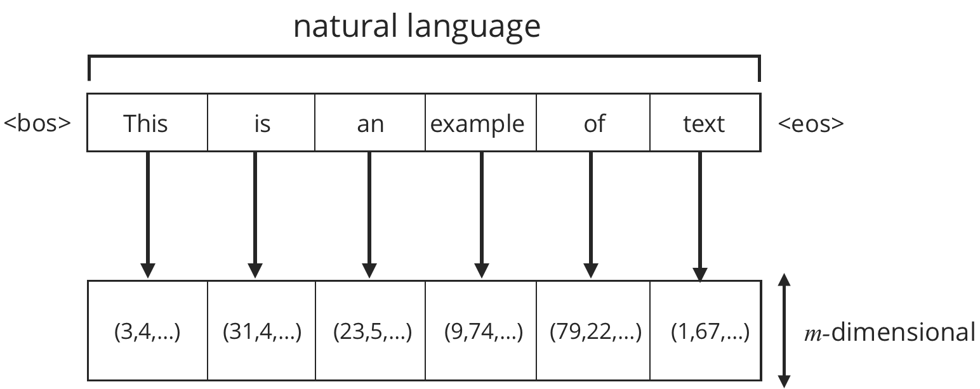
Converting a sentence to embeddings
We can construct a sequence of word embeddings to represent each sentence.
Each word is looked up in our dictionary individually
Specific tokens to mark “beginning of sentence” (<bos>) and “end of sentence” (<eos>)

Slide 34
How can we learn the dictionary?
We don’t start knowing this dictionary—must be learned from the data

Slide 35
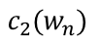
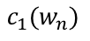
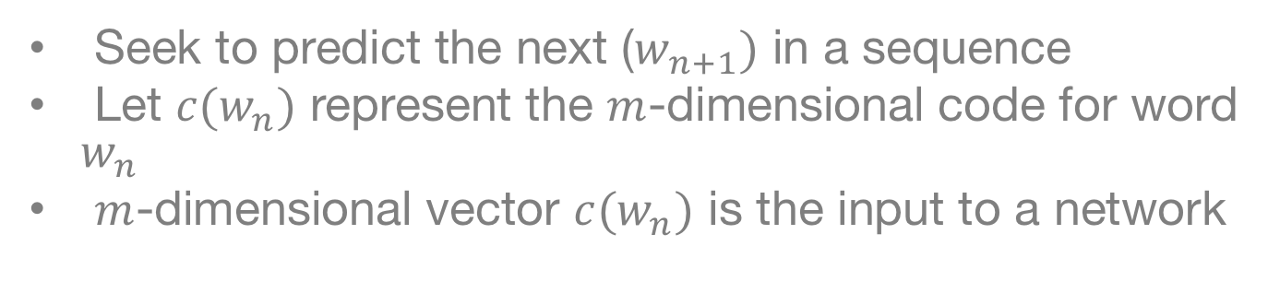
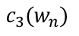
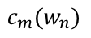
Unsupervised Learning of Word Vectors
Seek to predict the next ($w_{n+1})$ in a sequence
Let $c(w_{n})$ represent the $m$-dimensional code for word $w_{n}$
$m$-dimensional vector $c(w_{n})$ is the input to a network
$$c_{1}(w_{n})$$
$$c_{2}(w_{n})$$
$$c_{3}(w_{n})$$
$$c_{m}(w_{n})$$

Slide 36
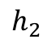
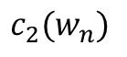
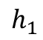
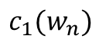
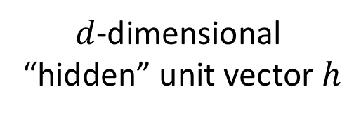
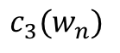



Model Construction
$$c_{1}(w_{n})$$
$$h_{1}$$
$$c_{2}(w_{n})$$
$$h_{2}$$
$$c_{3}(w_{n})$$
$$h_{3}$$
$d$-dimensional
“hidden” unit vector $h$
$$c_{m}(w_{n})$$
$$h_{d}$$

Slide 37












Model Construction
$$h_{j}=g\left[{ W}_{1j}⋅c_{1}+W_{2j}⋅ c_{2}+…+W_{mj}⋅c_{m}+b_{j}\right]$$
$$W$$
$$C_{1}$$
$$h_{1}$$
$$C_{2}$$
$$h_{2}$$
$g\left[x\right]$=tanh($x$)
$$C_{3}$$
$$h_{3}$$
$$C_{m}$$
$$h_{d}$$

Slide 38











Concise Description
$$W$$
$g\left[x\right]$=tanh($x$)
$$C_{1}$$
$$h_{1}$$
$$C_{2}$$
$$h_{2}$$
$$C_{3}$$
$$h_{3}$$
$$C_{m}$$
$$h_{d}$$
Vector
$$h=tanh\left[W⋅c+b\right]$$

Slide 39










Predicting Words
$$U$$
$$y_{1}$$
$$y_{2}$$
$$W$$
$$y_{3}$$
$$C_{1}$$
$$C_{2}$$
$$C_{3}$$
$$C_{m}$$
$$h$$
$$y_{V}$$

Slide 40

Predicting Words
$$U$$
$$y_{1}$$
$$y_{2}$$
$$W$$
$$y_{3}$$
$$C_{1}$$
$$C_{2}$$
$$C_{3}$$
Output Dimension
is $V$, our vocabulary size
$$C_{m}$$
$$h$$
$$y_{V}$$

Slide 41

Predicting Words
$$U$$
$$y_{1}$$
$$y_{2}$$
$$W$$
$$y_{3}$$
$$C_{1}$$
$$C_{2}$$
$$C_{3}$$
Output Dimension
is $V$, our vocabulary size
$$C_{m}$$
$$h$$
$$y_{V}$$
$$y_{v}={U_{1v}⋅h}_{1}+U_{2v}⋅h_{2}+⋯+{U_{dv}⋅h}_{d}+β_{v}$$
Concisely:
$$y=U⋅h+β$$

Slide 42












Predicting Words
$$U$$
$$y_{1}$$
$$y_{2}$$
$$W$$
$$y_{3}$$
$$C_{1}$$
$$C_{2}$$
$$C_{3}$$
$$C_{m}$$
$$h$$
$$y_{V}$$
Convert to probabilities:
$$p\left(w_{n+1}=i^{th} word | C\left(w_{n}\right)\right)=\frac{exp\left(y_{i}\right)}{exp\left(y_{1}\right)+exp\left(y_{2}\right)+…+exp\left(y_{V}\right)}$$

Slide 43




Predicting Words
$$U$$
$$y_{1}$$
$$p(w(1)|C)$$
$$y_{2}$$
$$p(w(2)|C)$$
$$W$$
$$y_{3}$$
$$p(w(3)|C)$$
$$C_{1}$$
$$C_{2}$$
$$C_{3}$$
Softmax
$$C_{m}$$
$$h$$
$$y_{V}$$
$$p(w(V)|C)$$
Convert to probabilities:
$$p\left(w_{n+1}=i^{th} word | C\left(w_{n}\right)\right)=\frac{exp\left(y_{i}\right)}{exp\left(y_{1}\right)+exp\left(y_{2}\right)+…+exp\left(y_{V}\right)}$$

Slide 44














Neural Text Model
$$y_{1}$$
$$p(w(1)|C)$$
$$U$$
$$y_{2}$$
$$p(w(2)|C)$$
$$W$$
$$p(w(3)|C)$$
$$y_{3}$$
$$C_{1}$$
$$C_{2}$$
$$C_{3}$$
Softmax
$$C_{m}$$
$$h$$
$$y_{V}$$
$$p(w(V)|C)$$

Slide 45
Neural Text Model
$$y_{1}$$
$$p(w(1)|C)$$
$$U$$
$$y_{2}$$
$$p(w(2)|C)$$
$$W$$
$$p(w(3)|C)$$
$$y_{3}$$
$$C_{1}$$
$$C_{2}$$
$$C_{3}$$
Softmax
$$C_{m}$$
$$h$$
$$y_{V}$$
Input: Word vector for
particular word in document
$$p(w(V)|C)$$

Slide 46
Neural Text Model
$$y_{1}$$
$$p(w(1)|C)$$
$$U$$
$$y_{2}$$
$$p(w(2)|C)$$
$$W$$
$$p(w(3)|C)$$
$$y_{3}$$
$$C_{1}$$
$$C_{2}$$
$$C_{3}$$
Softmax
$$C_{m}$$
$$h$$
$$y_{V}$$
$$p(w(V)|C)$$
Output: Probability of next word

Slide 47
Neural Text Model
$$y_{1}$$
$$p(w(1)|C)$$
$$U$$
$$y_{2}$$
$$p(w(2)|C)$$
$$W$$
$$p(w(3)|C)$$
$$y_{3}$$
$$C_{1}$$
$$C_{2}$$
$$C_{3}$$
Softmax
$$C_{m}$$
$$h$$
$$y_{V}$$
$$p(w(V)|C)$$
Will learn the word embedding to improved prediction of the next word.

Slide 48
Some Comments
This forms the basis of a text model
Can learn the dictionary to minimize the associated loss (i.e. predict next words as well as possible)
Can incorporate a larger history (more words)? Can we do this automatically?
How do we make this useful for predictions?

Slide 49
Lecture 2

Slide 50
Recurrent Neural Networks

Slide 51
Generating Text
Assume we have learned word embeddings (vectors) Want to use these embeddings in applications
Text synthesis may be of interest for automatic captioning of images, and for translation from one language to another
These tools are quite useful generally (will discuss in case studies)
We require additional tools for text synthesis: The recurrent neural network (RNN)

Slide 52

Using Word Embeddings
Our representation depends on the number of words
Not a constant number of features!

Slide 53













Recurrent Neural Network
Sequence of Word
Embeddings (sentence)
Model-Predicted
Next Word
$$h_{n−1}$$
Neural
Network
$$h_{n}$$
$$w_{n−1}$$
Softmax
$$w_{n}$$
$$h_{n}$$
Neural
Network
$$h_{n+1}$$
$$w_{n}$$
Softmax
$$w_{n+1}$$
$$h_{n+1}$$
Neural
Network
$$w_{n+1}$$
Softmax
$$w_{n+2}$$
$$h_{n+2}$$

Slide 54






Recurrent Neural Network
Sequence of Word
Embeddings (sentence)
Model-Predicted
Next Word
$$h_{n−1}$$
Neural
Network
$$h_{n}$$
$$w_{n−1}$$
Softmax
$$w_{n}$$
$$h_{n}$$
Neural
Network
$$h_{n+1}$$
$$w_{n}$$
Softmax
$$w_{n+1}$$
$$h_{n+1}$$
Neural
Network
$$w_{n+1}$$
Softmax
$$w_{n+2}$$
$$h_{n+2}$$

Slide 55
Recurrent Neural Network
Sequence of Word
Embeddings (sentence)
Model-Predicted
Next Word
$$h_{n−1}$$
Neural
Network
$$h_{n}$$
$$w_{n−1}$$
Softmax
$$w_{n}$$
$$h_{n}$$

Slide 56
Recurrent Neural Network
Sequence of Word
Embeddings (sentence)
Model-Predicted
Next Word
$$h_{n−1}$$
Neural
Network
$$h_{n}$$
$$w_{n−1}$$
Softmax
$$w_{n}$$
$$h_{n}$$

Slide 57


Recurrent Neural Network
Sequence of Word
Embeddings (sentence)
Model-Predicted
Next Word
$$h_{n−1}$$
Neural
Network
$$h_{n}$$
$$w_{n−1}$$
Softmax
$$w_{n}$$
$$h_{n}$$
Concatenate
$$Vector for w_{n−1}$$
$$h_{n−1}$$

Slide 58




Recurrent Neural Network
Sequence of Word
Embeddings (sentence)
Model-Predicted
Next Word
$$h_{n−1}$$
Neural
Network
$$h_{n}$$
$$w_{n−1}$$
Softmax
$$w_{n}$$
$$h_{n}$$
Concatenate
$$W$$
$$Vector for w_{n−1}$$
$$h_{n−1}$$
$$h_{n}$$

Slide 59



Recurrent Neural Network
Sequence of Word
Embeddings (sentence)
Model-Predicted
Next Word
$$h_{n−1}$$
Neural
Network
$$h_{n}$$
$$w_{n−1}$$
Softmax
$$w_{n}$$
$$h_{n}$$
$$W$$
$$Vector for w_{n−1}$$
$$h_{n−1}$$
$$h_{n}$$

Slide 60








Recurrent Neural Network
Sequence of Word
Embeddings (sentence)
Model-Predicted
Next Word
$$h_{n−1}$$
Neural
Network
$$h_{n}$$
$$w_{n−1}$$
Softmax
$$w_{n}$$
$$h_{n}$$
$$U$$
$$y_{1}$$
$$y_{2}$$
$$W$$
$$y_{3}$$
Softmax
$$Vector for w_{n−1}$$
$$h_{n−1}$$
$$h_{n}$$
$$y_{V−1}$$

Slide 61










Introduce Notation
$$U$$
$$y_{1}$$
$$y_{2}$$
$$W$$
$$y_{3}$$
Softmax
$$Vector for w_{n−1}$$
$$h_{n−1}$$
$$h_{n}$$
$$y_{V−1}$$
$$x_{n−1}$$
$$h_{n}=tanh(W⋅x_{n−1}+b)$$
$$p(w_{n}|w_{n−1},h_{n−1})=softmax(U⋅h_{n}+β)$$

Slide 62











Intuition on Model for Predicting nth Word
$$U$$
$$y_{1}$$
$$y_{2}$$
$$W$$
$$y_{3}$$
Softmax
$$Vector for w_{n−1}$$
$$h_{n−1}$$
$$h_{n}$$
$$y_{V−1}$$
$$x_{n−1}$$
$h_{n−1}:$Tells us which words were likely prior to selection of previous word (context)
$w_{n−1}$: Tells us which word was used/selected at point $n−1$ in text, as we predict the $n$th word

Slide 63
Recurrent Neural Network
Sequence of Word
Embeddings (sentence)
Model-Predicted
Next Word
$$h_{n−1}$$
Neural
Network
$$h_{n}$$
$$w_{n−1}$$
Softmax
$$w_{n}$$
$$h_{n}$$
Neural
Network
$$h_{n+1}$$
$$w_{n}$$
Softmax
$$w_{n+1}$$
$$h_{n+1}$$
Neural
Network
$$w_{n+1}$$
Softmax
$$w_{n+2}$$
$$h_{n+2}$$

Slide 64
Generating Text
Sequence of Word
Embeddings (sentence)
Model-Predicted
Next Word
$$h_{n−1}$$
Neural
Network
$$h_{n}$$
$$w_{n−1}$$
Softmax
$$w_{n}$$
$$h_{n}$$
Neural
Network
$$h_{n+1}$$
$$w_{n}$$
Softmax
$$w_{n+1}$$
$$h_{n+1}$$
Neural
Network
$$w_{n+1}$$
Softmax
$$w_{n+2}$$
$$h_{n+2}$$

Slide 65

Predicting a Single Output
Sequence of Word
Embeddings (sentence)
$$h_{n−1}$$
$$w_{n−1}$$
Neural
Network
$$h_{n}$$
Neural
Network
$$w_{n}$$
$$h_{n+1}$$
Neural
Network
$$<EOS>$$
Sigmoid
Predict at the end of the text.

Slide 66
















RNN with Memory Cells & Outputs
Sequence of Word
Embeddings (sentence)
Model-Predicted
Next Word
$$h_{n−1}$$
$$c_{n−1}$$
Neural
Network
$$h_{n}$$
$$w_{n−1}$$
Softmax
$$w_{n}$$
$$h_{n}$$
$$c_{n}$$
Neural
Network
$$h_{n+1}$$
$$w_{n}$$
Softmax
$$w_{n+1}$$
$$h_{n+1}$$
$$c_{n+1}$$
Neural
Network
$$w_{n+1}$$
Softmax
$$w_{n+2}$$
$$h_{n+2}$$
$$c_{n+2}$$

Slide 67
RNN with Memory Cells & Outputs
Sequence of Word
Embeddings (sentence)
Model-Predicted
Next Word
$$h_{n−1}$$
$$c_{n−1}$$
Neural
Network
$$h_{n}$$
$$w_{n−1}$$
Softmax
$$w_{n}$$
$$h_{n}$$
$$c_{n}$$
Neural
Network
$$h_{n+1}$$
$$w_{n}$$
Softmax
$$w_{n+1}$$
$$h_{n+1}$$
$$c_{n+1}$$
Neural
Network
$$w_{n+1}$$
Softmax
$$w_{n+2}$$
$$h_{n+2}$$
$$c_{n+2}$$
Memory Cells

Slide 68
RNN with Memory Cells & Outputs
Sequence of Word
Embeddings (sentence)
Model-Predicted
Next Word
$$h_{n−1}$$
$$c_{n−1}$$
Neural
Network
$$h_{n}$$
$$w_{n−1}$$
Softmax
$$w_{n}$$
$$h_{n}$$
$$c_{n}$$
Neural
Network
$$h_{n+1}$$
$$w_{n}$$
Softmax
$$w_{n+1}$$
$$h_{n+1}$$
$$c_{n+1}$$
Neural
Network
$$w_{n+1}$$
Softmax
$$w_{n+2}$$
$$h_{n+2}$$
$$c_{n+2}$$
Hidden Units

Slide 69






Recall Notation
$$W$$
$$Vector for w_{n−1}$$
$$h_{n−1}$$
$$h_{n}$$
$$x_{n−1}$$
Nonlinear function
$$h_{n}=f(W⋅x_{n−1}+b)$$

Slide 70


Tanh Nonlinear Function
$$h_{n}=tanh(W⋅x_{n−1}+b)$$

Slide 71


Sigmoid Nonlinear Function
Nonlinear function
$$h_{n}=σ(W⋅x_{n−1}+b)$$

Slide 72


RNN with Memory Cells & Outputs
Sequence of Word
Embeddings (sentence)
Model-Predicted
Next Word
$$h_{n−1}$$
$$c_{n−1}$$
Neural
Network
$$h_{n}$$
$$w_{n−1}$$
Softmax
$$w_{n}$$
$$h_{n}$$
$$c_{n}$$
As before, concatenate $w_{n−1} and h_{n−1} to constitute$
$$x_{n−1}=[w_{n−1},h_{n−1}]$$

Slide 73




RNN with Memory Cells & Outputs
Sequence of Word
Embeddings (sentence)
Model-Predicted
Next Word
$$h_{n−1}$$
$$c_{n−1}$$
Neural
Network
$$h_{n}$$
$$w_{n−1}$$
Softmax
$$w_{n}$$
$$h_{n}$$
$$c_{n}$$
As before, concatenate $w_{n−1} and h_{n−1} to constitute$
Introduce three control-gate vectors, $i_{n}, f_{n}, {and o}_{n}:$
$$x_{n−1}=[w_{n−1},h_{n−1}]$$
$$i_{n}=σ(W_{i}⋅x_{n−1}+b_{i})$$
$$f_{n}=σ(W_{f}⋅x_{n−1}+b_{f})$$
$$o_{n}=σ(W_{o}⋅x_{n−1}+b_{o})$$

Slide 74
RNN with Memory Cells & Outputs
Sequence of Word
Embeddings (sentence)
Model-Predicted
Next Word
$$h_{n−1}$$
$$c_{n−1}$$
Neural
Network
$$h_{n}$$
$$w_{n−1}$$
Softmax
$$w_{n}$$
$$h_{n}$$
$$c_{n}$$
As before, concatenate $w_{n−1} and h_{n−1} to constitute$
Introduce three control-gate vectors, $i_{n}, f_{n}, {and o}_{n}:$
$$x_{n−1}=[w_{n−1},h_{n−1}]$$
$$i_{n}=σ(W_{i}⋅x_{n−1}+b_{i})$$
$$f_{n}=σ(W_{f}⋅x_{n−1}+b_{f})$$
$$o_{n}=σ(W_{o}⋅x_{n−1}+b_{o})$$

Slide 75




RNN with Memory Cells & Outputs
Sequence of Word
Embeddings (sentence)
Model-Predicted
Next Word
$$h_{n−1}$$
$$c_{n−1}$$
Neural
Network
$$h_{n}$$
$$w_{n−1}$$
Softmax
$$w_{n}$$
$$h_{n}$$
$$c_{n}$$
$$o_{n}=σ(W_{o}⋅x_{n−1}+b_{o})$$
$$f_{n}=σ(W_{f}⋅x_{n−1}+b_{f})$$
$$i_{n}=σ(W_{i}⋅x_{n−1}+b_{i})$$
We introduce three distinct control neural networks, with respective weights
and biases $W_{o}, W_{f}, W_{i}, b_{o}, b_{f}, and b_{i}$
The outputs of these three neural networks, $o, f, i,$ are each vectors, the components
of which are each between zero and one

Slide 76



RNN with Memory Cells & Outputs
Sequence of Word
Embeddings (sentence)
Model-Predicted
Next Word
$$h_{n−1}$$
$$c_{n−1}$$
Neural
Network
$$h_{n}$$
$$w_{n−1}$$
Softmax
$$w_{n}$$
$$h_{n}$$
$$c_{n}$$
New estimate of memory-cell values
Update the memory cell as
$${\tilde{c}}_{n}=tanh(W_{c}⋅x_{n−1}+b_{c})$$
$$c_{n}=f_{n}⊙c_{n−1}+i_{n}⊙{\tilde{c}}_{n}$$

Slide 77
RNN with Memory Cells & Outputs
Sequence of Word
Embeddings (sentence)
Model-Predicted
Next Word
$$h_{n−1}$$
$$c_{n−1}$$
Neural
Network
$$h_{n}$$
$$w_{n−1}$$
Softmax
$$w_{n}$$
$$h_{n}$$
$$c_{n}$$
New estimate of memory-cell values
Update the memory cell as
$${\tilde{c}}_{n}=tanh(W_{c}⋅x_{n−1}+b_{c})$$
$$c_{n}=f_{n}⊙c_{n−1}+i_{n}⊙{\tilde{c}}_{n}$$

Slide 78


RNN with Memory Cells & Outputs
Sequence of Word
Embeddings (sentence)
Model-Predicted
Next Word
$$h_{n−1}$$
$$c_{n−1}$$
Neural
Network
$$h_{n}$$
$$w_{n−1}$$
Softmax
$$w_{n}$$
$$h_{n}$$
$$c_{n}$$
$${\tilde{c}}_{n}=tanh(W_{c}⋅x_{n−1}+b_{c})$$
$$c_{n}=f_{n}⊙c_{n−1}+i_{n}⊙{\tilde{c}}_{n}$$

Slide 79





RNN with Memory Cells & Outputs
Sequence of Word
Embeddings (sentence)
Model-Predicted
Next Word
$$h_{n−1}$$
$$c_{n−1}$$
Neural
Network
$$h_{n}$$
$$w_{n−1}$$
Softmax
$$w_{n}$$
$$h_{n}$$
$$c_{n}$$
$${\tilde{c}}_{n}=tanh(W_{c}⋅x_{n−1}+b_{c})$$
$$c_{n}=f_{n}⊙c_{n−1}+i_{n}⊙{\tilde{c}}_{n}$$
$$f_{n}$$
$$×$$
$$×$$
$$⋯$$
$$×$$
$$c_{n−1}$$

Slide 80








RNN with Memory Cells & Outputs
Sequence of Word
Embeddings (sentence)
Model-Predicted
Next Word
$$h_{n−1}$$
$$c_{n−1}$$
Neural
Network
$$h_{n}$$
$$w_{n−1}$$
Softmax
$$w_{n}$$
$$h_{n}$$
$$c_{n}$$
$${\tilde{c}}_{n}=tanh(W_{c}⋅x_{n−1}+b_{c})$$
$$c_{n}=f_{n}⊙c_{n−1}+i_{n}⊙{\tilde{c}}_{n}$$
$$f_{n}$$
$$×$$
$$×$$
$$⋯$$
$$×$$
$$c_{n−1}$$
$$f_{n}⊙c_{n−1}$$

Slide 81
RNN with Memory Cells & Outputs
Sequence of Word
Embeddings (sentence)
Model-Predicted
Next Word
$$h_{n−1}$$
$$c_{n−1}$$
Neural
Network
$$h_{n}$$
$$w_{n−1}$$
Softmax
$$w_{n}$$
$$h_{n}$$
$$c_{n}$$

Slide 82

RNN with Memory Cells & Outputs
Sequence of Word
Embeddings (sentence)
Model-Predicted
Next Word
$$h_{n−1}$$
$$c_{n−1}$$
Neural
Network
$$h_{n}$$
$$w_{n−1}$$
Softmax
$$w_{n}$$
$$h_{n}$$
$$c_{n}$$
$$x_{n−1}=[w_{n−1},h_{n−1}]$$

Slide 83




RNN with Memory Cells & Outputs
Sequence of Word
Embeddings (sentence)
Model-Predicted
Next Word
$$h_{n−1}$$
$$c_{n−1}$$
Neural
Network
$$h_{n}$$
$$w_{n−1}$$
Softmax
$$w_{n}$$
$$h_{n}$$
$$c_{n}$$
$$o_{n}=σ(W_{o}⋅x_{n−1}+b_{o})$$
$$f_{n}=σ(W_{f}⋅x_{n−1}+b_{f})$$
$$i_{n}=σ(W_{i}⋅x_{n−1}+b_{i})$$
$${\tilde{c}}_{n}=tanh(W_{c}⋅x_{n−1}+b_{c})$$
Four Neural Networks

Slide 84

RNN with Memory Cells & Outputs
Sequence of Word
Embeddings (sentence)
Model-Predicted
Next Word
$$h_{n−1}$$
$$c_{n−1}$$
Neural
Network
$$h_{n}$$
$$w_{n−1}$$
Softmax
$$w_{n}$$
$$h_{n}$$
$$c_{n}$$
$$o_{n}=σ(W_{o}⋅x_{n−1}+b_{o})$$
$$f_{n}=σ(W_{f}⋅x_{n−1}+b_{f})$$
$$i_{n}=σ(W_{i}⋅x_{n−1}+b_{i})$$
$${\tilde{c}}_{n}=tanh(W_{c}⋅x_{n−1}+b_{c})$$
$$c_{n}=f_{n}⊙c_{n−1}+i_{n}⊙{\tilde{c}}_{n}$$
Update Memory Cell

Slide 85

RNN with Memory Cells & Outputs
Sequence of Word
Embeddings (sentence)
Model-Predicted
Next Word
$$h_{n−1}$$
$$c_{n−1}$$
Neural
Network
$$h_{n}$$
$$w_{n−1}$$
Softmax
$$w_{n}$$
$$h_{n}$$
$$c_{n}$$
$$o_{n}=σ(W_{o}⋅x_{n−1}+b_{o})$$
$$f_{n}=σ(W_{f}⋅x_{n−1}+b_{f})$$
$$i_{n}=σ(W_{i}⋅x_{n−1}+b_{i})$$
$${\tilde{c}}_{n}=tanh(W_{c}⋅x_{n−1}+b_{c})$$
$$c_{n}=f_{n}⊙c_{n−1}+i_{n}⊙{\tilde{c}}_{n}$$
$$h_{n}=o_{n}⊙{tanh(c}_{n})$$
Update Memory Cell
Output Hidden Vector

Slide 86







LSTM-Based Text Synthesis
Assume we have trained the parameters of an LSTM using a large document corpus
How may we use the LSTM to synthesize text?
Use Most Likely
Word from Softmax
$$h_{0}$$
$$c_{0}$$
Neural
Network
$$h_{1}$$
$$<bos>$$
Softmax
$$w_{1}$$
$$h_{1}$$
$$c_{1}$$

Slide 87




LSTM-Based Text Synthesis
$$h_{0}$$
$$c_{0}$$
Neural
Network
$$h_{1}$$
$$<bos>$$
Softmax
$$w_{1}$$
$$h_{1}$$
$$c_{1}$$

Slide 88




LSTM-Based Text Synthesis
$$h_{0}$$
$$c_{0}$$
Neural
Network
$$h_{1}$$
$$<bos>$$
Softmax
$$w_{1}$$
$$h_{1}$$
$$c_{1}$$
Neural
Network
$$h_{2}$$
$$w_{1}$$
$$h_{2}$$
$$c_{2}$$

Slide 89

LSTM-Based Text Synthesis
$$h_{0}$$
$$c_{0}$$
Neural
Network
$$h_{1}$$
$$<bos>$$
Softmax
$$w_{1}$$
$$h_{1}$$
$$c_{1}$$
Use Most Likely
Word from Softmax
Neural
Network
$$h_{2}$$
$$w_{1}$$
Softmax
$$w_{2}$$
$$h_{2}$$
$$c_{2}$$

Slide 90



LSTM-Based Text Synthesis
$$h_{0}$$
$$c_{0}$$
Neural
Network
$$h_{1}$$
$$<bos>$$
Softmax
$$w_{1}$$
Use Most Likely
Word from Softmax
$$h_{1}$$
$$c_{1}$$
Neural
Network
$$h_{2}$$
$$w_{1}$$
Softmax
$$w_{2}$$
$$h_{2}$$
$$c_{2}$$
Neural
Network
$$w_{2}$$
$$h_{3}$$
$$c_{3}$$

Slide 91



LSTM-Based Text Synthesis
$$h_{0}$$
$$c_{0}$$
Neural
Network
$$h_{1}$$
$$<bos>$$
Neural
Network
Softmax
$$w_{1}$$
$$h_{1}$$
$$c_{1}$$
Neural
Network
$$h_{2}$$
$$w_{1}$$
Softmax
$$w_{2}$$
Use Most Likely
Word from Softmax
$$h_{2}$$
$$c_{2}$$
Neural
Network
$$h_{3}$$
$$w_{2}$$
Softmax
$$w_{3}$$
$$h_{3}$$
$$c_{3}$$

Slide 92
LSTM-Based Text Synthesis
$$h_{0}$$
$$c_{0}$$
Neural
Network
$$h_{1}$$
$$<bos>$$
Neural
Network
Softmax
$$w_{1}$$
$$h_{1}$$
$$c_{1}$$
Neural
Network
$$h_{2}$$
$$w_{1}$$
Softmax
$$w_{2}$$
Use Most Likely
Word from Softmax
$$h_{2}$$
$$c_{2}$$
Neural
Network
$$h_{3}$$
$$w_{2}$$
Softmax
$$w_{3}$$
$$h_{3}$$
$$c_{3}$$

Slide 93
Image-to-Caption

Slide 94
Text Translation
translate.google.com

Slide 95
Conclusions
Word embeddings and recurrent neural networks are currently the cornerstones of natural language processing
Nearly all text systems are based on these techniques (e.g. google translate, chatbots, etc.)
Many more versions of Recurrent Neural Networks
Long-Short Term Memory (LSTM) to build a “memory”
Stacking recurrent units to make deep recurrent networks
The Transformer Network is a new variant that achieves similar goals

